Slide 1
Find at least 3 isomorphic representation for the same circuit matrix
Group 10

Slide 2
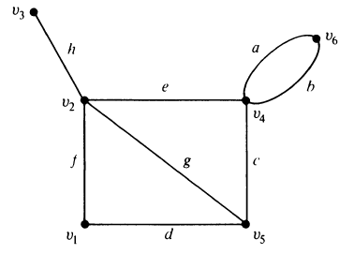
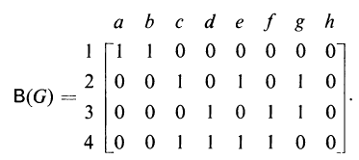
Introduction
Circuit Matrix contains all the circuits as rows and all edges as columns.
If edge of Graph (V,E) is a part of given circuit then put 1 else 0.
Example:
Graph G (V,E)
B(G) is a circuit matrix

Slide 3


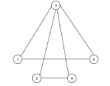
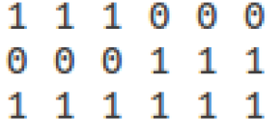
Contd..
Isomorphic Graph: Two graphs are isomorphic if these two have same number of graph vertices connected in the same manner.
Circuit Matrix
Isomorphic Graph for the shown Circuit Matrix

Slide 4
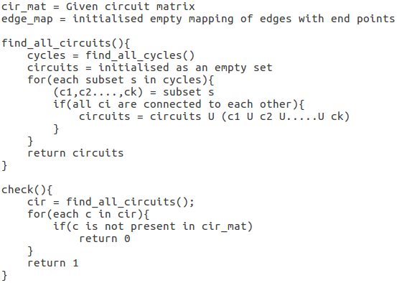
Proposed Approach
Algorithm 1:

Slide 5
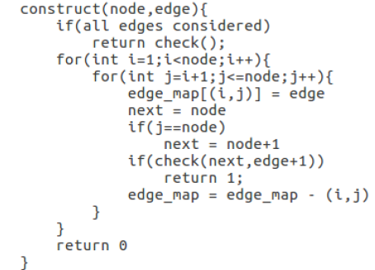
Algorithm 2:

Slide 6
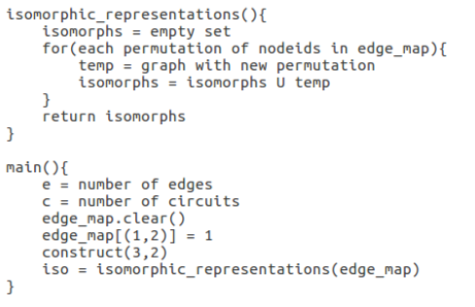
Algorithm 3:

Slide 7
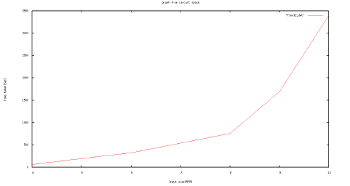
Input Size Vs Time Complexity Graph

Slide 8
Conclusion
An algorithm has been proposed to construct atleast 3 isomorphic representations of the same Circuit Matrix.
Firstly a simple Graph has been constructed with the given Circuit Matrix.
After that, the nodes were assigned different ids for different representations.
The Overall Time Complexity comes out to be Exponential.

